Slide 1
Topic Name : Artificial Neural Networks for Survival Data
Presented By
Rushikesh Pawar.(Applied Statistics 32)
Suhas Pawar.(Applied Statistics 41)
PROJECT GUIDE
Mr. Agniva Das
DEPARTMENT OF STATISTICS
SARDAR PATEL UNIVERSITY
VALLABH VIDYANAGAR

Slide 2
OUTLINE
Introduction
Objectives
Brief terms
Data source
Exploratory Data Analysis
Survival Model fitting
Neural Network Model fitting
Conclusion

Slide 3
Introduction
Survival analysis is the study of time to an event of interest , such as disease occurrence or death .
This study uses both Artificial Neural Networks (ANN) model and Survival models for COVID-19 data to understand which factors affect the status (life) of patient .

Slide 4
Objectives
To establish guideline of Artificial Neural Networks for survival data.
To check whether Artificial Neural Networks are performing better for Survival data.
To compare traditional Survival models with Artificial Neural Network models .

Slide 5
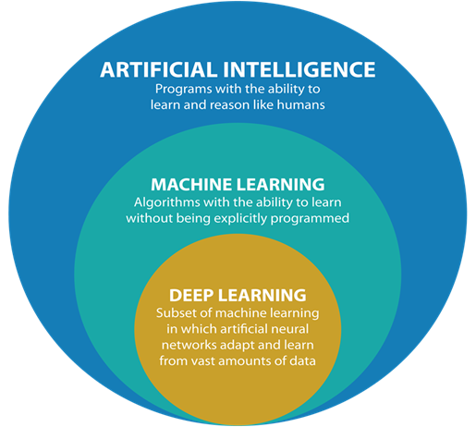
Brief terms :

Slide 6
Why Deep learning ?
Machine Learning algorithms can handle high-dimensional data, but the performance and accuracy of these algorithms can be impacted by the increasing number of dimensions
Deep Learning algorithms, which are based on artificial neural networks, are designed to handle large amounts of data, including high-dimensional data, and can automatically extract features from the data to improve the performance of the model.
Machine learning is not ideal for image processing. Object detection requires high dimensional data and Machine learning cannot be used for data sets only with restricted number of features

Slide 7

Neural Networks
Neural Networks approach problems in a very different way by trying to mimic how neurons in the human brain work.
In fact, they learn by example rather than being programmed to perform a specific task.
Technically, they are composed of a large number of highly interconnected processing elements (nodes) that work in parallel to solve a specific problem, which is similar to how the human brain works.

Slide 8
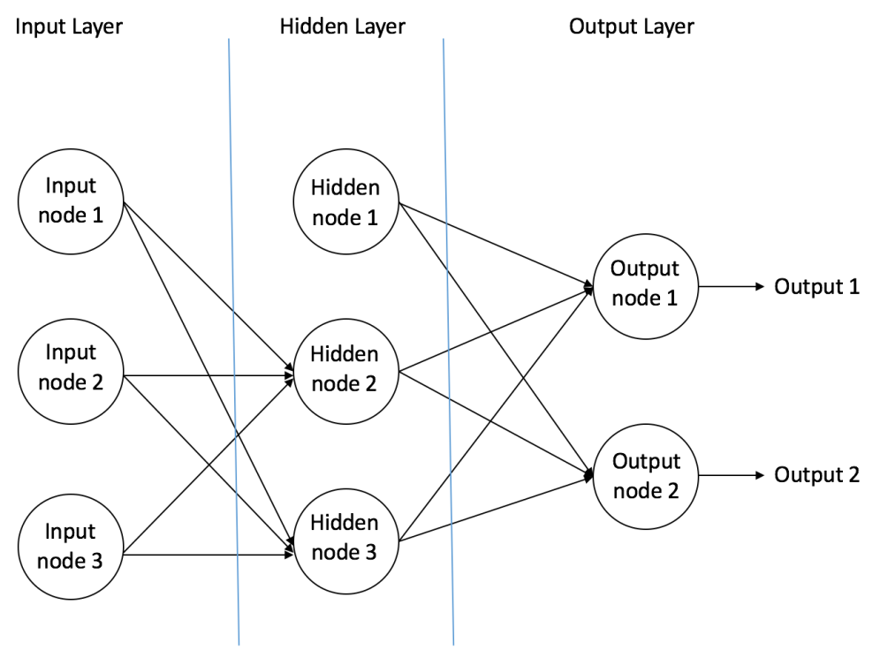
Each layer is composed of “neurons” also known as “perceptrons”.
Neural Network has three basic layers :
Input layer, Hidden layer, Output layer

Slide 9
Input Node - An input node contains the input of the network and this input is always numerical. If the input is not numerical by default, it is always converted.
Hidden Node - A hidden node is a node within a hidden layer. A hidden layer can have many hidden nodes, and there are various theories for implementing the correct amount.
Output Node - An output node is a node within an output layer. There can be a single or multiple output nodes depending on the objective of the network.

Slide 10
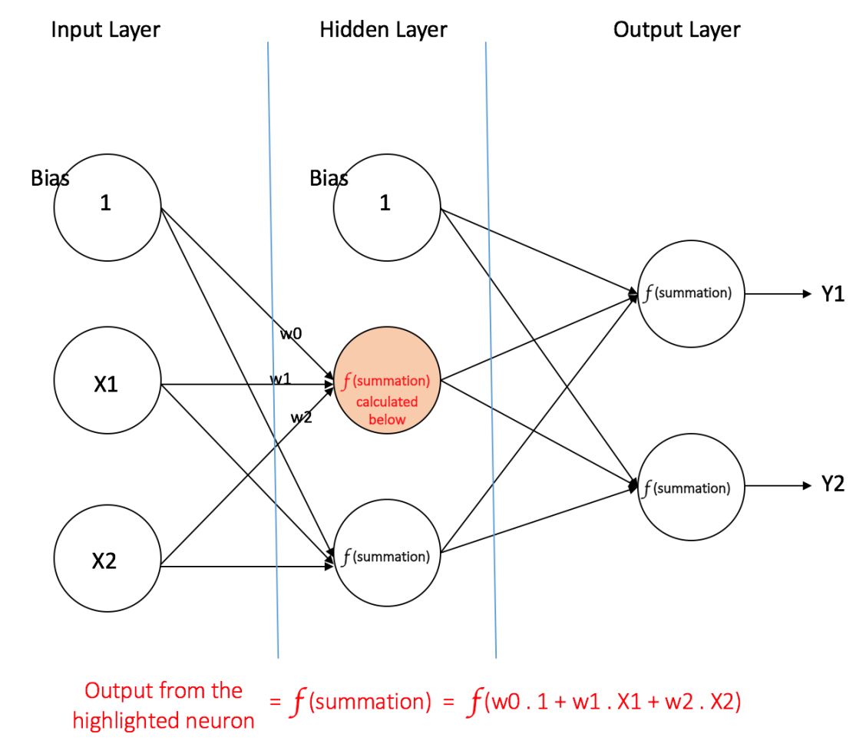
Bias Value - A bias node is an extra node added to each hidden and output layer, and it connects to every node within each respective layer.

Slide 11
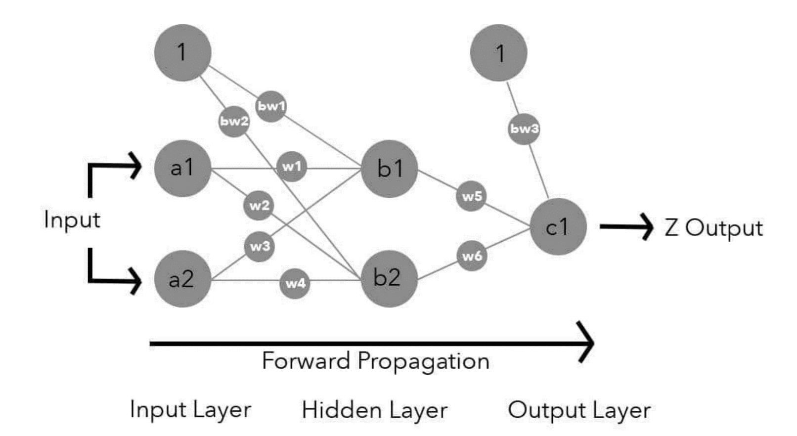
Weight Value - A weight is a variable that sits on an edge between nodes. The output of every node in a layer is multiplied by a weight, then summed with other weighted nodes in that layer to become the net input of a node in the following layer
Forward Propagation

Slide 12
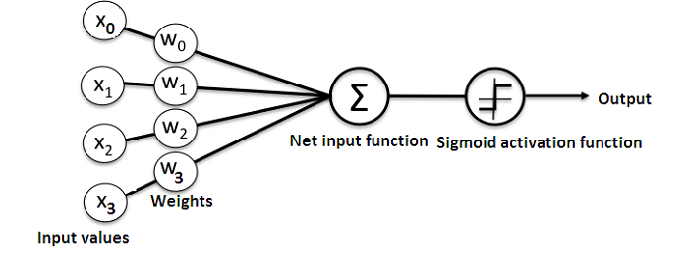
Forward propagation : we can investigate how input moves through the network to become output. This process is technically called forward propagation.
When input is passed into the network, it moves from one layer to the next until it passes through the output layer.An Activation functions are repeatedly used to make all of this possible.

Slide 13
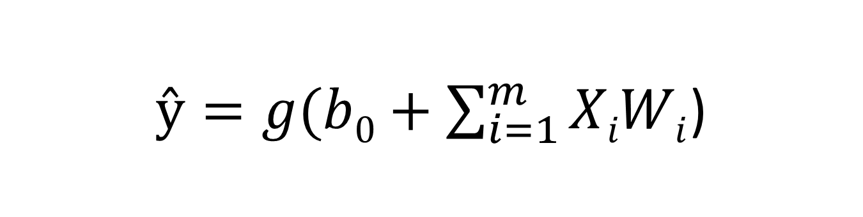
$ŷ=g(b0+\sum_{i=1}^{m}{XiWi}$)
Output
Non-linear Activation function
Bias
Linear combination of inputs
Activation function :
purpose of Activation function is to introduce non linearity into the network . It is an transformation that we do over the input before sending it to the next layer of neurons
Some of the types of Activation function are
Sigmoid Function (also called as logistic activation function )
Hyperbolic Tangent function (tanh)
Rectified Linear Unit (ReLU)

Slide 14

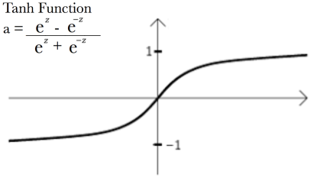


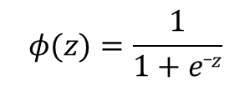
Sigmoid Function
$$φ(z)=\frac{1}{1+e_z}$$
Hyperbolic Tangent
$$x=\frac{\text{e}\text{z} \text{−} \text{e}\text{z} }{\text{e}\text{z} \text{+} \text{e}\text{z} }$$
Rectified Linear Unit (ReLU)
R(z)= max(0,z)

Slide 15
BackPropagation : Backpropagation is algorithm to train ( adjust weight ) of neural network . We need to use this algorithm to train Neural Network . Loss Function :Within a neural network, a Loss function transforms everything that occurs within the network into a number that represents the total error of the network. Essentially, it is a measure of how wrong a network is.There are many types of cost functions to choose from. Popular options include the Mean Squared Error, Squared Error, Root Mean Square Error and Sum of Square Errors . Loss Optimization algorithm: It minimizes loss of the network and gives maximum accuracy . Types are SGD , ADAM

Slide 16
Types of Neural Networks
Feed-forward Neural Network
Recurrent Neural Network
Convolutional Neural Network

Slide 17
Feed-Forward Neural Networks
Feed-forward neural networks are inspired by the information processing of one or more neural cells, called a neuron.
In this neural network information is only processed in one direction , hence the connections between nodes does not form a cycle.

Slide 18
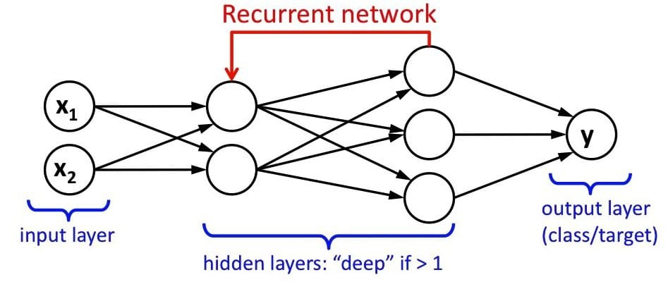
Recurrent Neural Network
The main and most important feature of RNN is Hidden state, which remembers some information about a sequence.
RNN converts the independent activations into dependent activations by providing the same weights and biases to all the layers, thus reducing the complexity of increasing parameters and memorizing each previous outputs by giving each output as input to the next hidden layer.

Slide 19
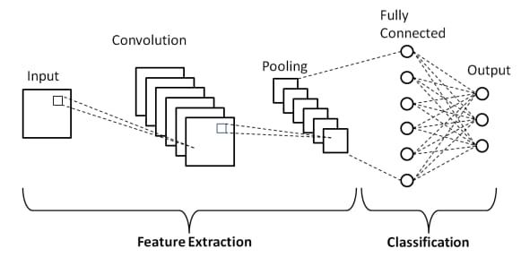
Convolutional neural networks
CNN is a combination of Feed-Forward and Recurrent Neural Network .
Convolution : Apply filter (set of weights) to generate feature map .

Slide 20
Data Source
The data of COVID-19 patients of Karnataka state is collected from the website
https://www.isibang.ac.in/~athreya/incovid19/data.htmlwebsite
Which is official website of Indian Statistical Institute , Bangalore centre .

Slide 21
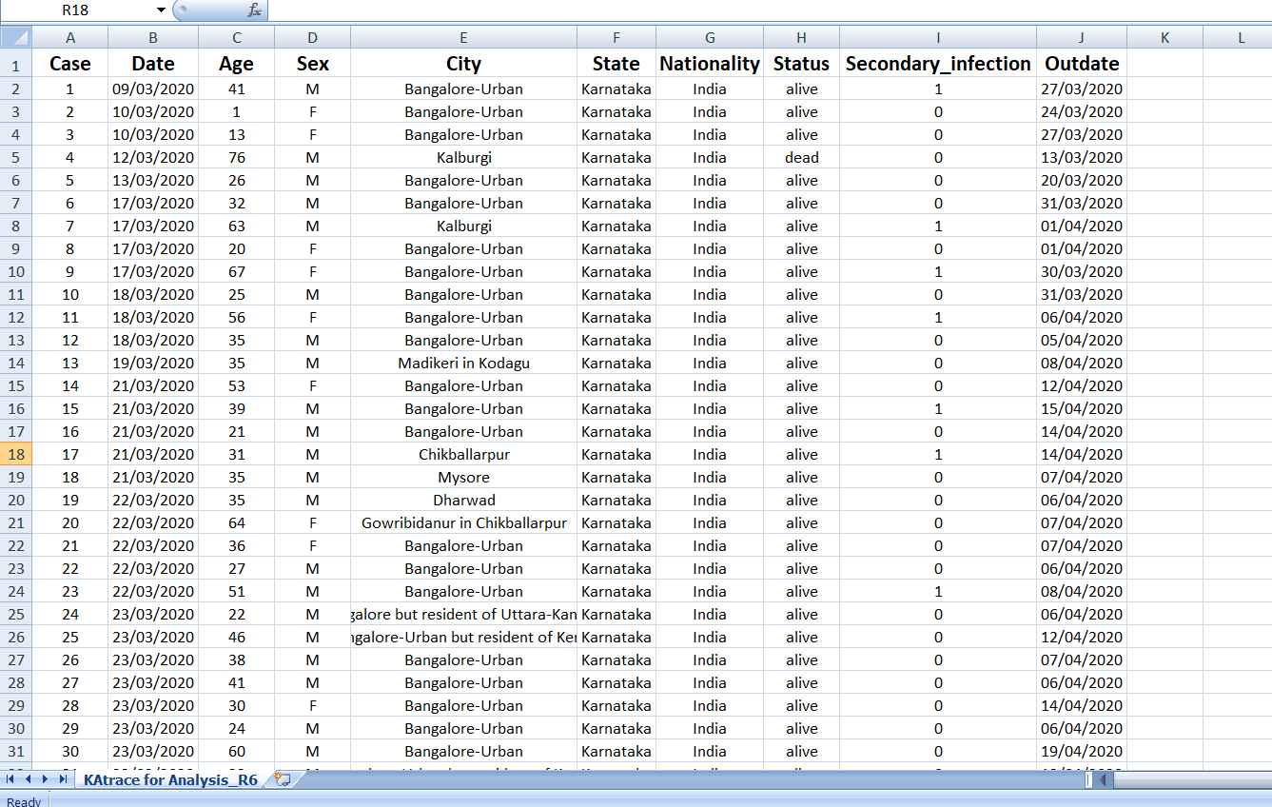
Data description

Slide 22
Data set contains 26261 rows and 10 columns one row corresponds to one case in Karnataka state . For each patient the columns contains following information as
“case number” , ”Date” , ”Age” , “Sex” , “City” , “State” , “Nationality” , “Status” , “Secondary infection” , “Out date”
Secondary infection indicates
0 : no secondary infection
1 : secondary infection

Slide 23
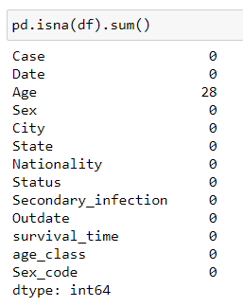
Exploratory Data Analysis
To check whether missing values
Only Age column has 28 missing values

Slide 24
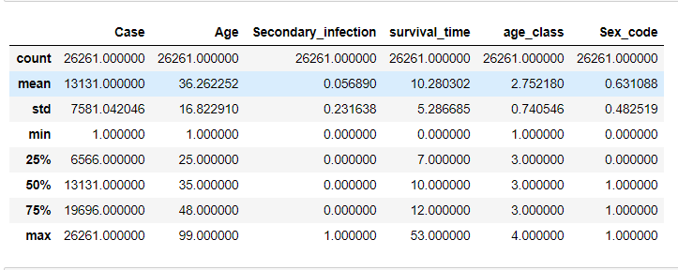
Summary Statistics

Slide 25
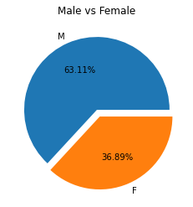
Pie chart for Gender
Data contains 63.11 % Male patients
and 36.89 % of Female patients.

Slide 26
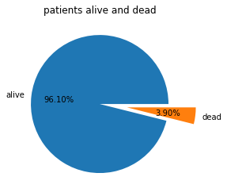
Status of patients
96.10 % patients are alive and 3.90 % patients are dead by corona virus disease

Slide 27
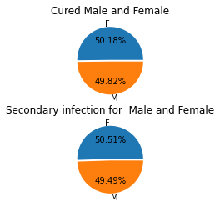
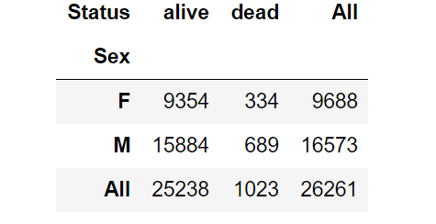
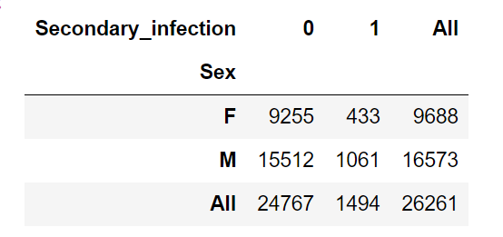
Crosstab of Status vs Gender and Secondary infection vs Gender
Here we say that, Cured and secondary infection has same effect on Male and Female patients

Slide 28
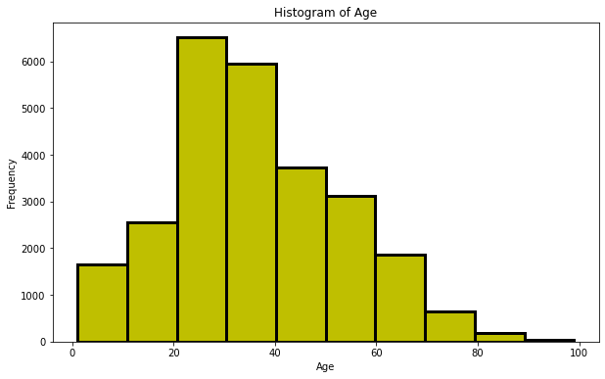
Histogram of Age
Maximum number of corona virus patients are in 20-40 age group

Slide 29
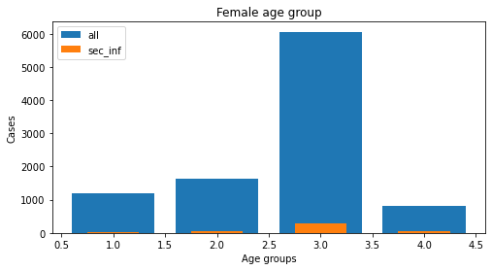
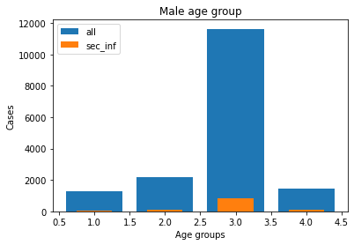
Bar chart of Age groups in Four categories for Male and Female
1 : Children(0-14 years)
2 : Youth(15-24 years)
3 : Adult(25-60 years)
4 : Seniors(60 and over years)
In both cases, majority of patients caused by corona virus are Adults

Slide 30
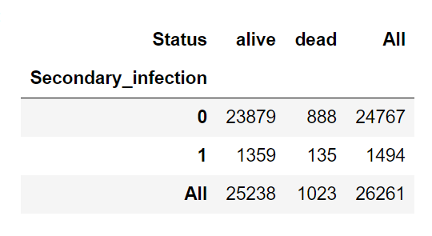
Chi-square test for association
The chi-square tes of independence is used to determine there is a significant relationship between two nominal (categorical) variables.
The frequency of each category for one nominal variable is compared across the categories of the second nominal variable.
The data can be displayed in a contingency table where each row represents a category for one variable and each column represents a category for the other variable.

Slide 31
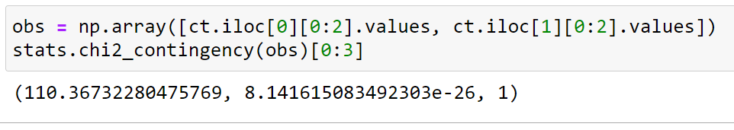
Hypothesis :
H₀ : There is no significant relationship between ‘Status of patient’ and ‘Secondary infection’
H₁ : There is significant relationship between ‘Status of patient’ and ‘Secondary infection’.
Here , P-value < 0.05 with 1 degrees of freedom ,
Hence we reject H₀ at 5% level of significance .
i.e., There is Significant relationship between ‘Status of patient’ and ‘Secondary infection’

Slide 32
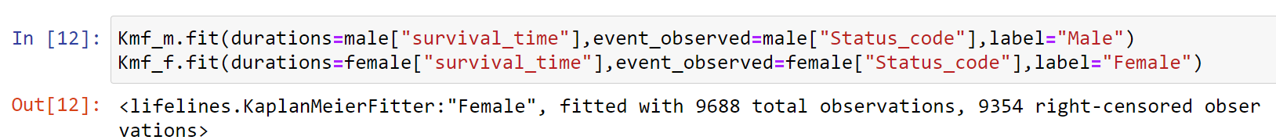
Survival Models
Kaplan-Meier estimator :
We require lifelines library
From lifelines import KaplanMeierFitter
Event Table : one most important method of kmf object is event table it gives various information for data fitted .

Slide 33
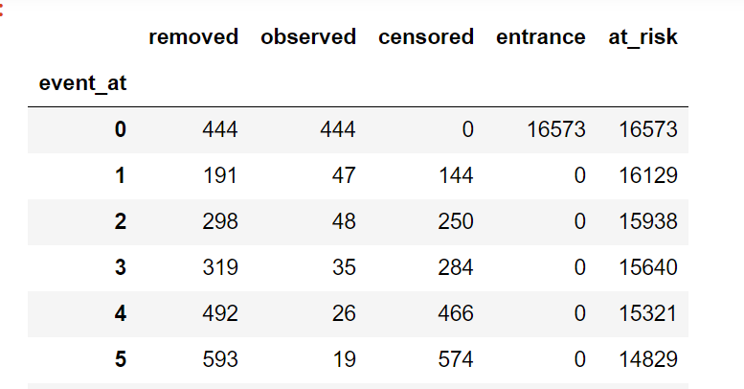
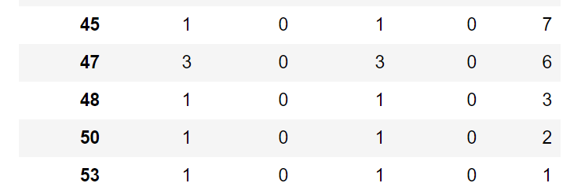
Event table for male

Slide 34
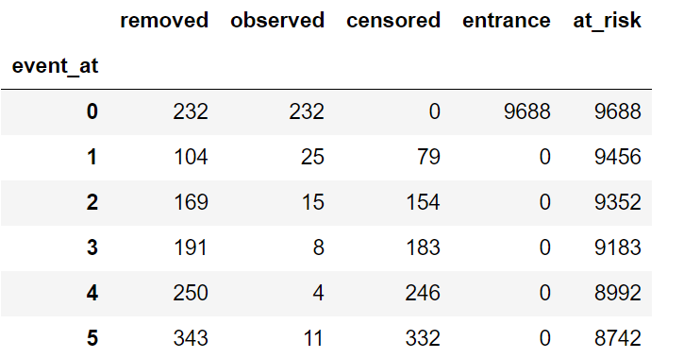
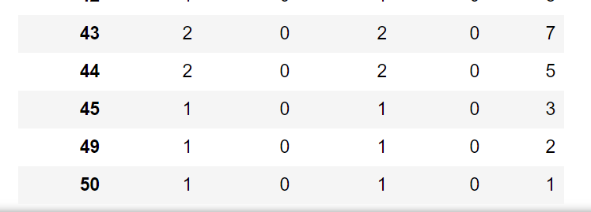
Event table for Female

Slide 35
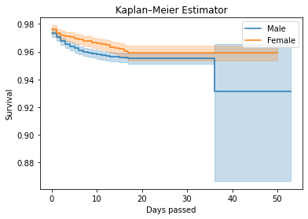
KMF Survival Graph (Male , Female)
Notice that probability of female patient surviving in covid pandemic is higher than male patients.

Slide 36
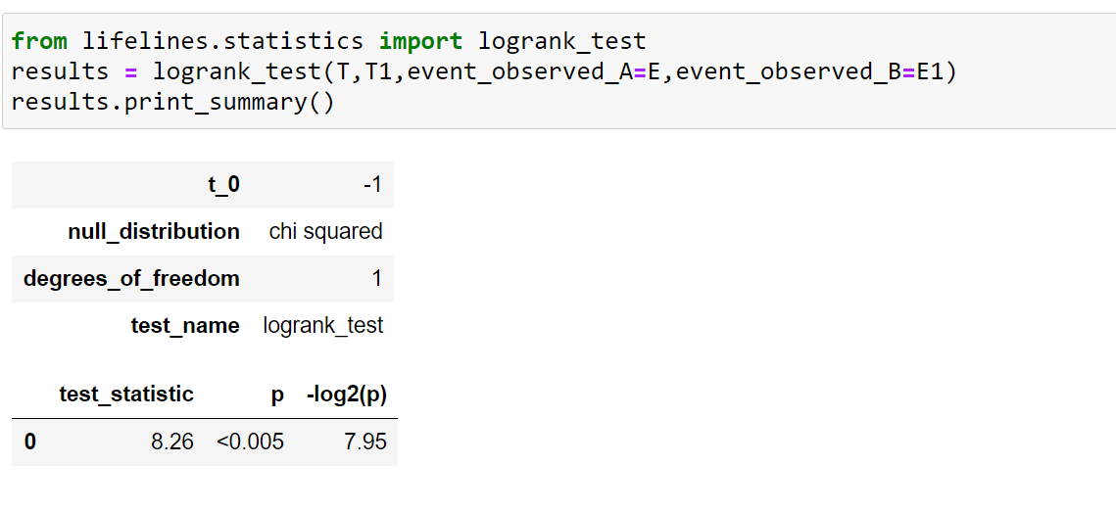
Log-Rank test : The log rank test is a popular test to test the null hypothesis of no difference in survival between two or more independent groups.
H₀ : There is no significant difference between the groups being studied.
H₁ : There is significant difference between the groups being studied.
Here, P-value < 0.05 with 1 degrees of freedom ,hence we reject ho
i.e., Gender is associated with survival days

Slide 37
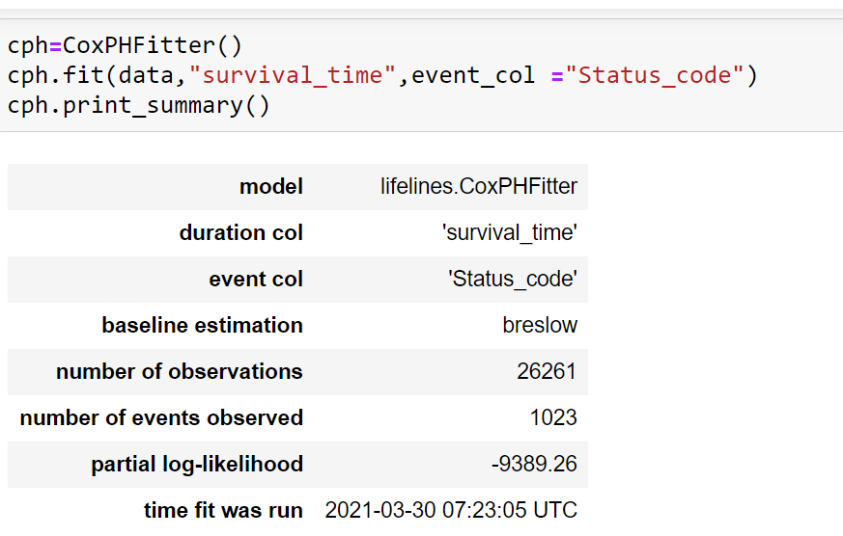
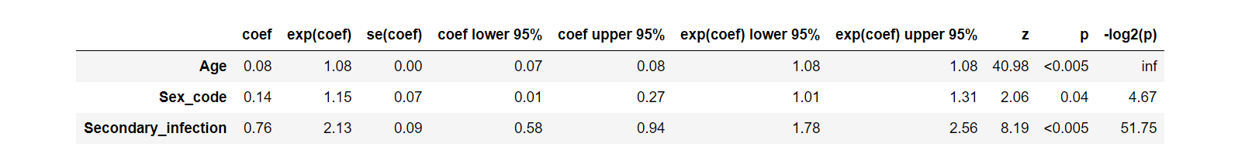
Cox-proportional Hazard Model :

Slide 38
HR = 1 : No Effect.
HR < 1 : Reduction in the Hazard.
HR > 1 : Increase in Hazard.
Interpretation :
p-value for secondary infection is < 0.05
and the Hazard ratio is 2.13 indicates that strong relationship between secondary infection and increased risk of death .

Slide 39
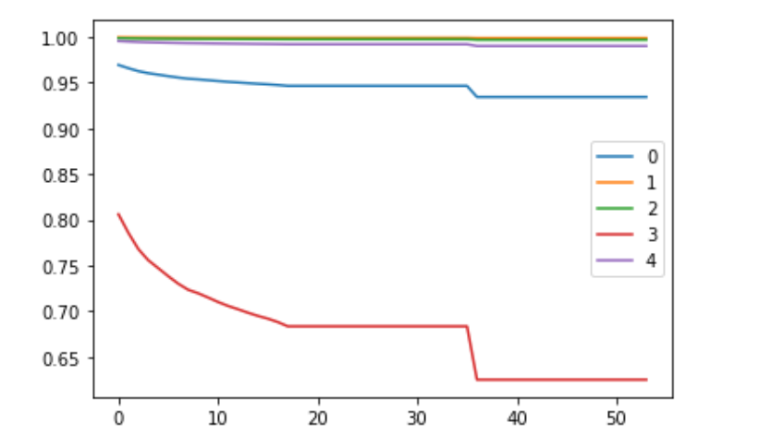
Survival probability for first 5 patients
Here, survival probability of fourth Patient is very low as compared to other patients

Slide 40
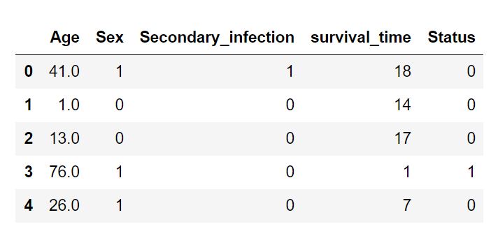
Feed forward Neural Network for Survival Data
We Modify data to use in Neural Network

Slide 41
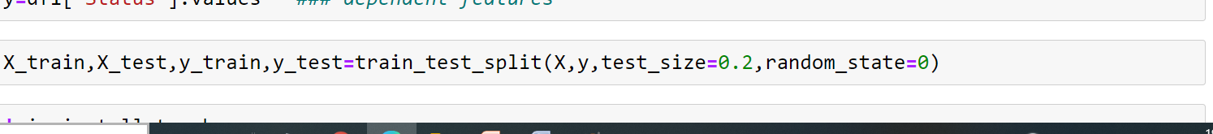
Splitting data in Train set and Test set
Install torch library to build neural network

Slide 42
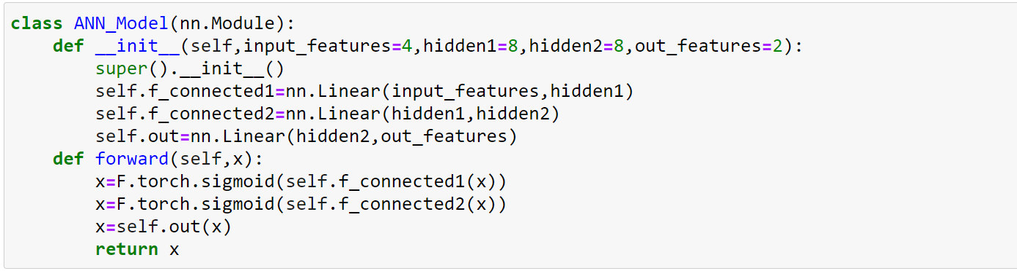
Build up Neural Network
We construct neural network with Input layer having 4 nodes , two hidden layers each having 8 nodes and output layer having two nodes .
Using Sigmoid Activation function

Slide 43
Back –Propagation
We use Loss function as Cross entropy and loss optimizer function as Adam(Adaptive moment estimation)
We choose Epoch = 500
(What is an Epoch? In terms of artificial neural networks, an epoch refers to one cycle through the full training dataset.)

Slide 44
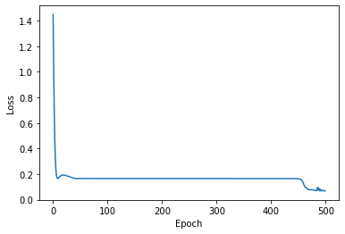
Loss Function Plot
As Epoch increases loss of model decreases

Slide 45
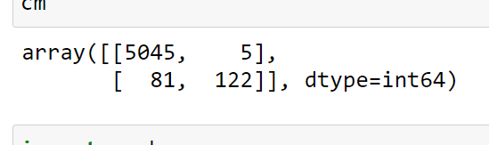
Prediction on Test data
Confusion Matrix :

Slide 46
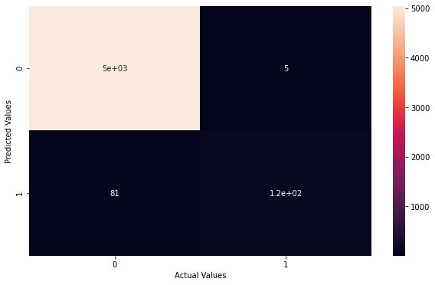
Heat-map of Confusion matrix
Model predicts 5167 data points correctly where as 86 data points incorrectly .

Slide 47
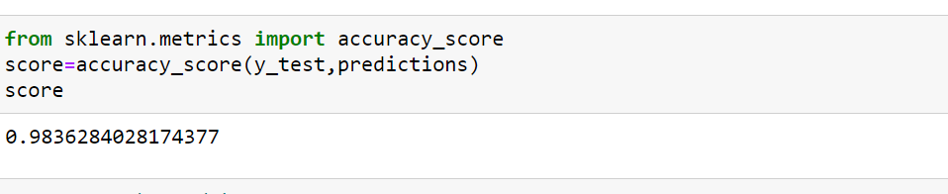
Model accuracy :
Fitted Model gives 98.36 % accuracy on test data .

Slide 48
Conclusion
Neural Network Model gives maximum accuracy for Survival data by predicting Status of patients ( i.e., dead or alive ) .
Model predicts that Secondary infection affects highly on status of patient rather than Age and Gender .
As cases increases survival time of patients decreases .

Slide 49
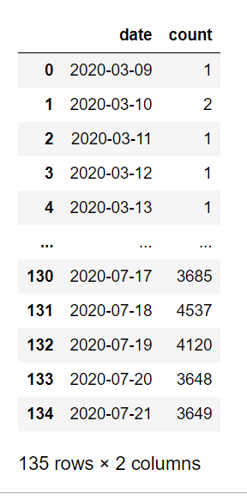
LSTM for forecasting number of patients for next 10 days
Preparing data for further process :
Data set contains 135 dates in sequence

Slide 50
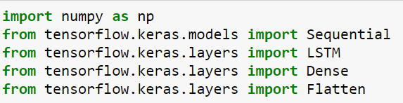
First 125 dates are used to train model.
Installed tensorflow and keras libraries to build neural network.
Import Sequential,LSTM,Dense,Flatten.

Slide 51
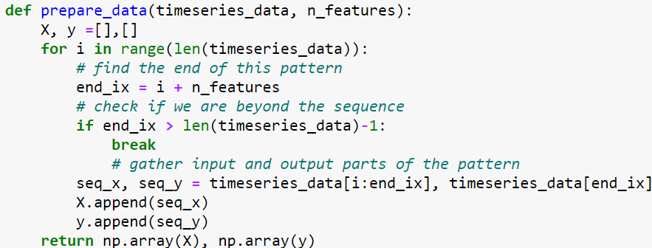
Preparing function for splitting data

Slide 52
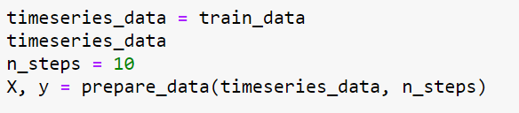
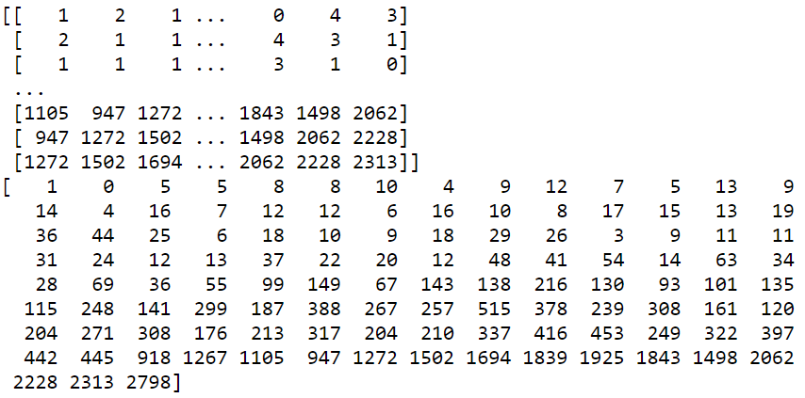
Splitting data into 115 rows , each row having 10 steps(data points).

Slide 53
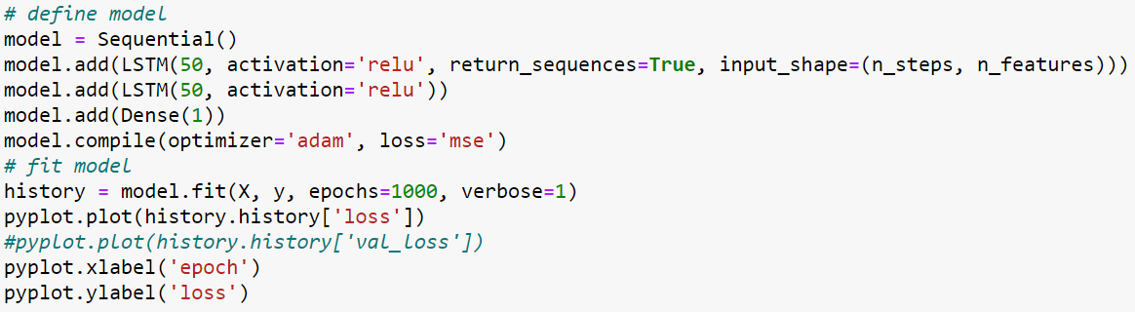
Building LSTM Model

Slide 54
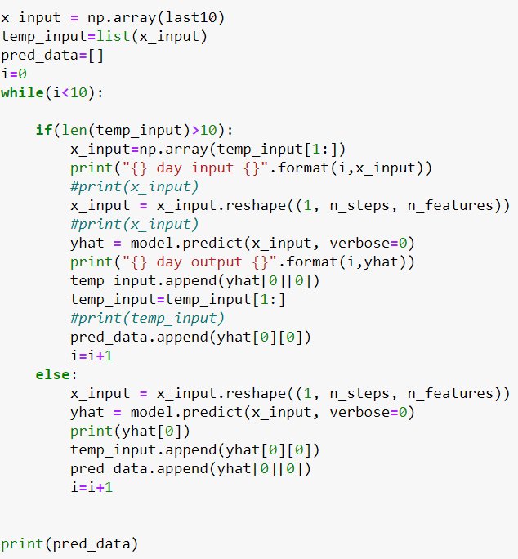
Demonstrate prediction for next 10 days

Slide 55
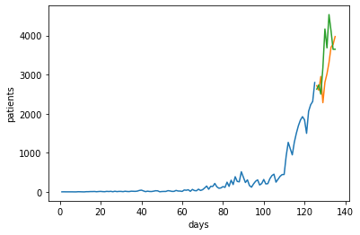
Visualizing Output
As days passes number of patients increases .
Green line indicates forecasted number of patients ,where as Orange line indicates actual numbers.

Slide 56
The Accuracy of Model is calculated by “Mean Absolute Percentage Error”(MAPE).
M = 1/n Ʃ ǀ(A_{t} –F_{t} )/A_{t}ǀ * 100
M=mean absolute percentage error
N =number of times the summation iteration happens
A_{t} = actual value
F_{t} =forecast value
The MAPE for the model is 23.19 . Model contains 23.19 % error in forecasted values.

Slide 57
Conclusion
From Kaplan–Meier estimator we conclude that probability of female patient surviving in covid pandemic is higher than male patients .
From cox-proportional model there is strong relationship between secondary infection and increased risk of death .
Feed-forward Neural Network gives 98.36% Accuracy for survival data by predicting status of patients (i.e, dead or alive) .
LSTM model gives forecasted number of patients for next 10 days with 23.19% error .

Slide 58
References
John P.Klein , Hans C. van Houwelingen , Joseph G. Ibrahim , Thomas H. Scheike : Handbook of Survival Analysis .
David W. Hosmer Stanley Lemeshow Susanne may : Applied Survival Analysis
Miachel Taylour :Make Your Own Neural Network_ An In-Depth Visual Introduction for Beginners .
Research papers :
Early triage of critically ill covid 19 patients using deep learning.
Brown 1997 : on the use of ANN for Analysis of Survival data .
Feed Forward NN for the Analysis of censoring Survival Data : Partial logistic regression approach .

Slide 59


